Slide 1
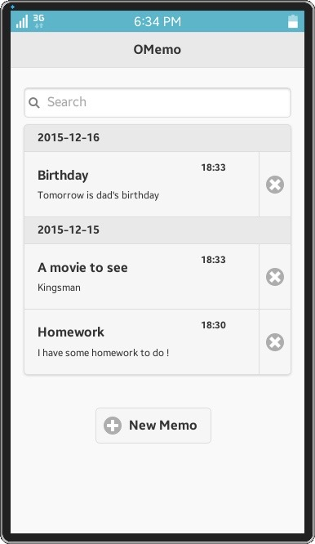
OMemo
App Information | Screen Shot
[Introduction] Just as the name suggests, OMemo is a light and simple memorandum application based on HTML5. It contains a small set of common used functions which can help you memorise your future plans, daily routines, and even your homework to do. [Usage] You can have a quick start with OMemo by: Create a new memo Delete an existed memo Search a memo with key words Check and modify the old memo
Main Page
*Participating Devices: Tizen Virtual Machine v2.4.0

Slide 2
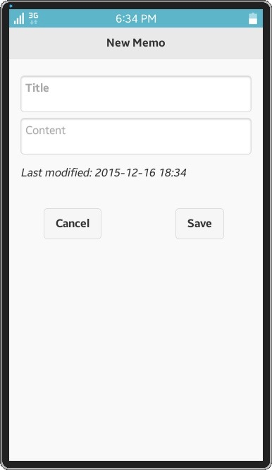
OMemo
App Information | Screen Shot
[Features] Light weight Fresh and comfortable UI Memos listed in order of time modified Search items with Ajex technology [Technology dependence] jQuery for JavaScript operation jQuery mobile for User Interface
Create a new memo
*Participating Devices: Tizen Virtual Machine v2.4.0

